Slide 1

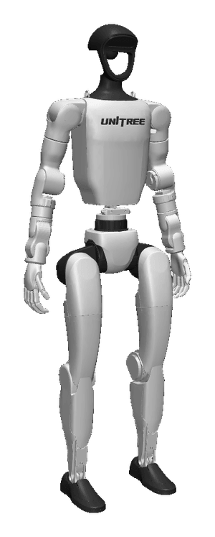
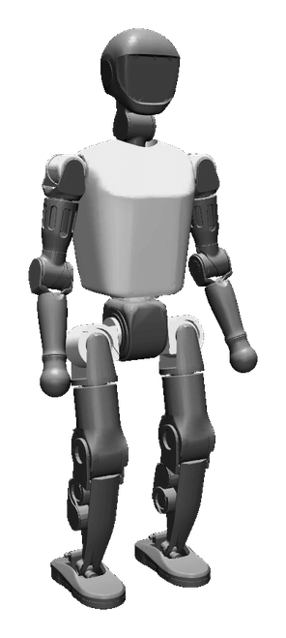
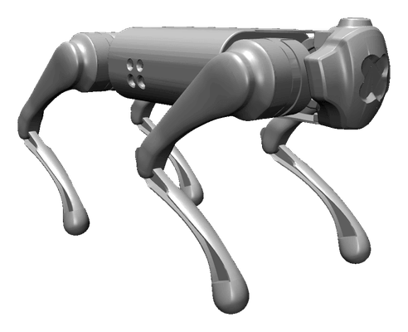
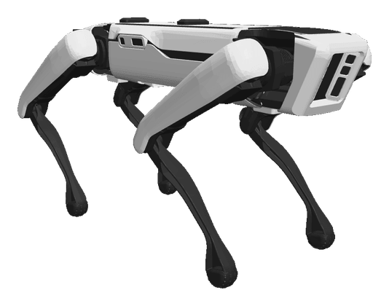
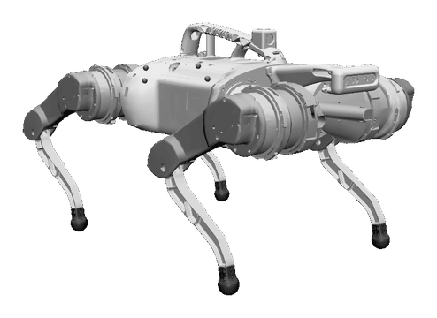
PRE-SEED · OCTOBER 2026
BACKED BY
Inoki Labs
We find where a robot's AI breaks, in simulation, before it breaks on real hardware.
TESTED IN SIMULATION ON
Unitree Go1
Boston Dynamics Spot
Google Barkour
Unitree G1
Booster T1
Vihan Aggarwal · Subhi Stephan
Robot models: MuJoCo Menagerie

Slide 2
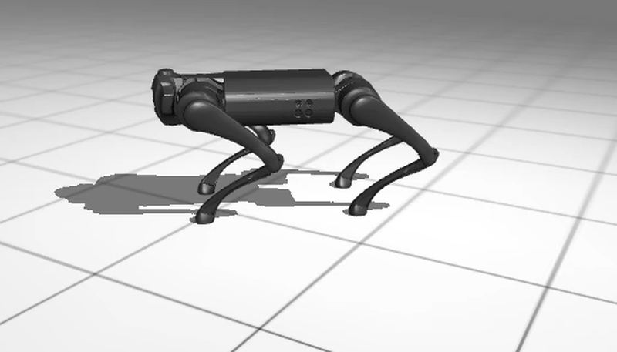
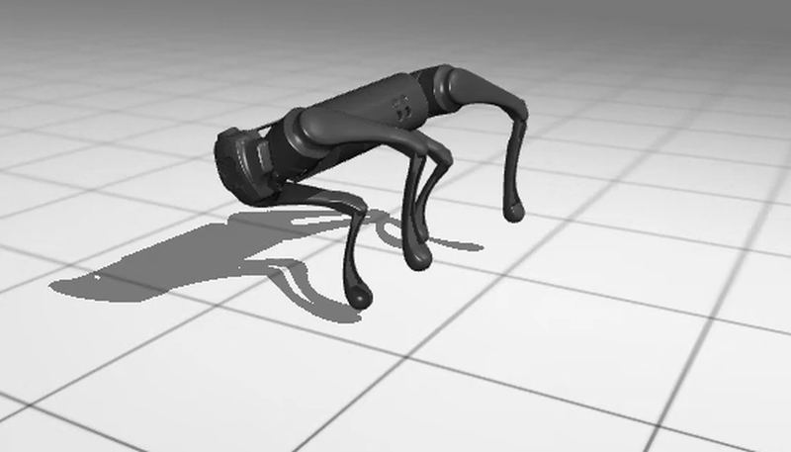
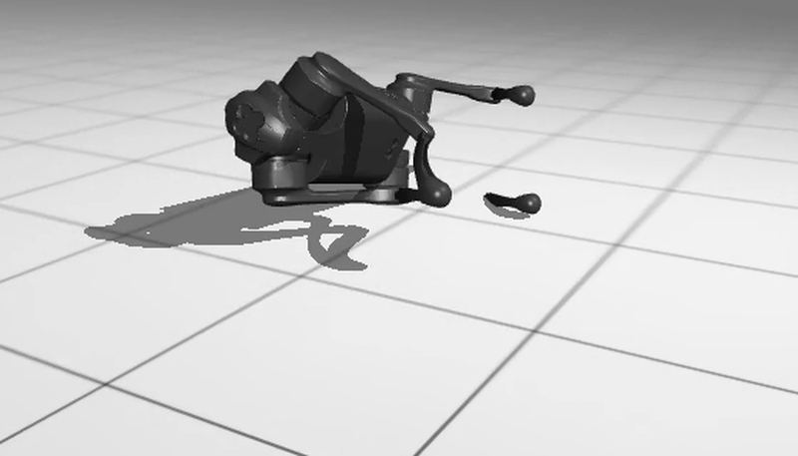
01 / PROBLEM
INOKI LABS
Robots learn to walk in simulation. Nobody checks where they will fall.
0.0 s · walking
1.2 s · tipping
1.4 s · down
A real failure our search found: a trained Unitree Go1 controller goes from walking to down in 1.4 seconds. Simulation.
Teams ship new robot software faster than they can test it on real robots.
~140
$2.37B
humanoid robot companies worldwide in 2026
invested in humanoid startups in Q1 2026 alone
Frames from our MuJoCo MJX run. Funding: Tracxn via axis-intelligence.com.
02 / 9

Slide 3
02 / HOW IT WORKS
INOKI LABS
Inoki Labs takes a policy you already trained and returns failures, a fix and a gate.
01
02
03
04
05
Search
Cluster
Verify
Repair
Gate
Multi-start search for worlds where the fixed policy fails.
Group failures into named families, with causes and video.
Replay exactly. Re-check under other physics settings and in a second engine.
Fine-tune against the failures. Measure before and after on fixed realistic worlds.
Blocks a regressing release in CI. About 1% false alarms. Signed reports.
IN
WHERE
OUT
A checkpoint you already trained. Importers for ONNX, Isaac, RSL-RL and Unitree formats.
Your own GPUs and your own CI. Policy weights never leave your machines.
Failure families with video, a fix, and a pass or fail gate before hardware.
Engine: Python, JAX and MuJoCo MJX, running on GPUs.
03 / 9

Slide 4
03 / EVIDENCE: SEARCH
INOKI LABS
Directed search finds failures closer to normal operating conditions, at equal budget.
SIM · Go1
SIM · CPU smoke
SYNTHETIC · no physics
12,800
2×
5.8 of 6
simulated worlds searched in one real run, grouped into 4 named failure families.
as many failures inside plausible deployment ranges as random sampling: 304 vs 156 of 384 rollouts.
planted failure modes found by 16 parallel restarts, against 1.8 of 6 for a single search at equal cost.
96.7% of search-selected worlds failed. These were chosen adversarially, so it is not a real-world failure probability.
Nearest failure 0.82 from nominal, vs 1.07 random and 1.12 RoboGate-style. Two seeds; our objective favors plausible worlds.
Most of the gain is filling the GPU batch. One large single search reaches 4.8 of 6.
SIM
Cross-engine check: 12 failures replayed in a second simulator engine, with full agreement on one run.
Simulation only (MuJoCo MJX) unless tagged otherwise. Synthetic means a planted test landscape on CPU.
04 / 9

Slide 5
04 / EVIDENCE: REPAIR
INOKI LABS
On Go1 and Spot, Inoki Labs roughly halves the failure left after standard randomization.
ROBOT
FROZEN
STANDARD DR
INOKI LABS BEST
DISTILLED POLICY
Go1
80.0%
32.6%
16.7%
bp_wide · 2nd seed 22.8%
20.6%
Spot
90.9%
60.9%
34.4%
bp_wide
36.8%
Barkour
53.1%
45.5%
43.9%
bp_wide
40.2%
G1
90.2%
86.3%
78.4%
bp_ft
84.7%
T1
92.1%
89.4%
84.9%
bp_ft
89.6%
Failure rate on 2,048 paired simulated worlds, lower is better. The Inoki Labs column is the best of about 8 methods per robot: bp_wide on quadrupeds, bp_ft on humanoids (bp_ft on Go1 is 64.3%). Go1 has two seeds, 16.7% and 22.8%; other robots one. On Barkour the distilled policy beats it. Humanoid gains over standard practice are real but small, 4 to 8 points.
SIM · MuJoCo MJX · simulation only · re-checked against the results file 2026-10-10
05 / 9

Slide 6
05 / MARKET
INOKI LABS
Every robot that learns has to be tested. That market is about to be enormous.
$38B
humanoid robot market by 2035 (Goldman Sachs, 2024)
HUMANOID ROBOT MARKET BY 2050
$5T
$3B+
spent on robot training data, including simulation, over two years (Bessemer, 2026)
$1.4B
robotics simulation software by 2030 (ABI Research)
Morgan Stanley, "Humanoids: A $5 Trillion Market," 2025
HOW WE CHARGE
Pilot $15K one-off · Team $50K a year · Enterprise $200K a year. Starting with the ~140 humanoid companies and legged-robot teams.
Third-party forecasts of the markets we sell into. Prices are working assumptions, not yet set.
06 / 9

Slide 7
06 / COMPETITION
INOKI LABS
Others build the sim or run the sweep. Inoki Labs searches a fixed policy.
PLAYER
WHAT IT DOES
OUR DIFFERENCE
Drift
LLM agent that sets up ROS2 simulations. Strong distribution (Product Hunt #5).
Sets up the sim but does not search it. Publishes no evaluation numbers.
NVIDIA Isaac Lab-Arena
Open-source GPU policy evaluation, 250+ tasks.
Runs sweeps you define, not adversarial search. A platform to integrate with.
RoboGate (academic)
Boundary sampling, a risk model and a gate, for manipulation.
Locomotion and repair. At equal budget our failures sit about 25% nearer nominal.
Enact (YC S26)
Finds failures on physical robots, then retrains. Manipulation.
Simulation first, before hardware time. Locomotion.
Applied Intuition, Foretellix
Vehicle scenario generation and coverage verification.
Vehicles, not learned robot policies. Applied Intuition is a likely acquirer.
Runtime.si (YC F26)
"Evaluation layer for physical intelligence": scenario tests before deployment.
Closest startup. Product not public; our method, code and numbers are.
Prior art we build on and do not claim: Active Domain Randomization (2019), Bayesian Safety Validation (2023), Shi et al. (RSS 2024). Our claim is the combination: GPU-batched search, locomotion randomization, multiple robots, and cluster, verify, repair and a statistical release gate in one tool.
Our reading of public material. RoboGate figure: our reimplementation, simulation.
07 / 9

Slide 8
07 / TEAM
INOKI LABS
A robotics researcher and a go-to-market lead, backed early by Antler.
Vihan Aggarwal
Subhi Stephan
CO-FOUNDER · CEO AND CGO
CO-FOUNDER · CTO AND CMO
MIT CSAIL, Mantis AI fellow (Kellis Lab)
Purdue TRACE Lab: acoustic gas-leak detection on a quadruped
IEEE Best Paper, AIIoT 2026: tendon-driven soft robotic arm (patent pending)
Yale GRAB Lab and Nazarbayev ARM Lab
Author of kinfast, a batched, differentiable robot kinematics library
Duke University: biomedical engineering and ECE
Top 10 finalist, Blue Ocean Competition, the largest student entrepreneurship competition
Research intern at MIT
Drug discovery research at Mount Sinai
Early-stage backing from Antler.
Inoki Labs
08 / 9

Slide 9
08 / THE ASK
INOKI LABS
Raising $100K
to buy a real humanoid and prove that failures we find in simulation happen on real robots.
WHAT THE MONEY BUYS
01
02
03
A Unitree G1
A GPU rig
Real-world testing
Our own humanoid, to reproduce simulated failures on real hardware.
Run thousands of simulated worlds per batch, in-house.
More on-robot trials, with the results measured against simulation.
WHAT IT PROVES
Failures found in simulation rank real-robot failures the same way, with confidence intervals. Then 2 to 3 outside teams run Inoki Labs on their own robots.
Unitree G1
Every result so far is in simulation. This round is how we test it on hardware.
09 / 9

